Slide 1

The Function
(and other mathematical and
computational preliminaries)
In Ryu
September 1, 2016

Slide 2
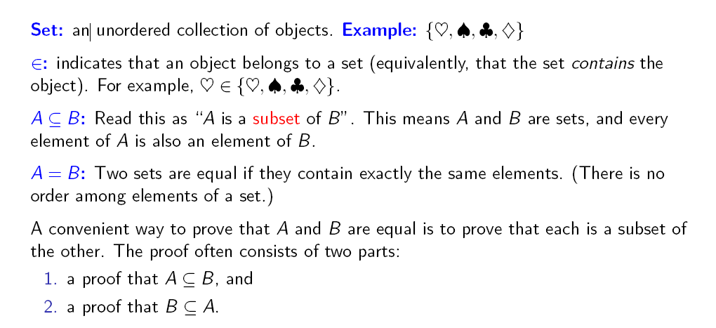
Set terminology and notation

Slide 3
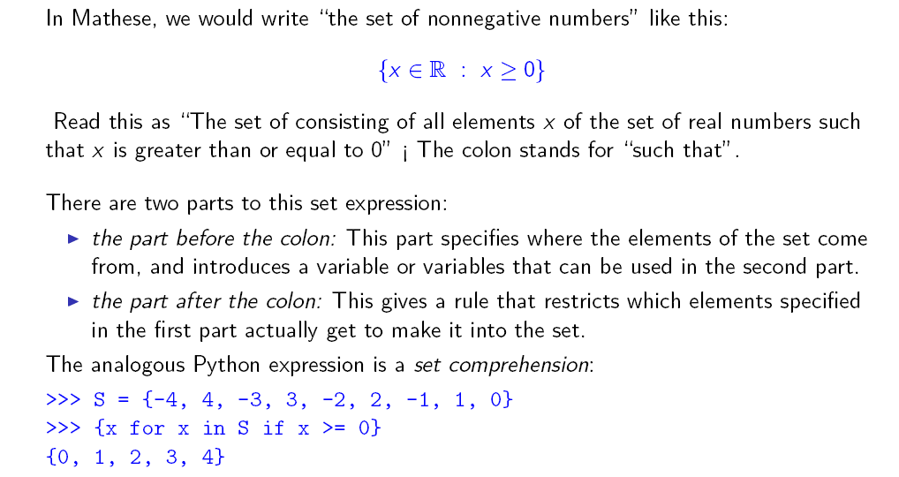
Set expressions

Slide 4
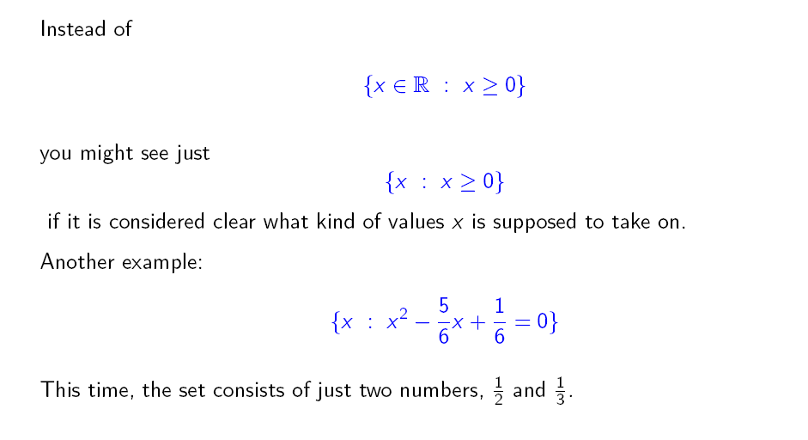
Set expressions

Slide 5
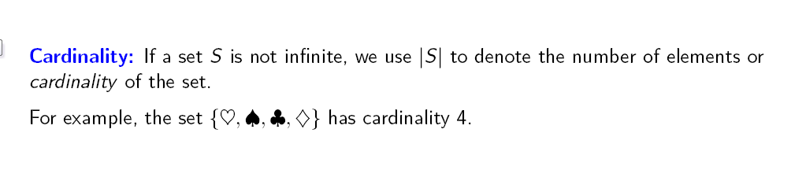
Set terminology and notation

Slide 6
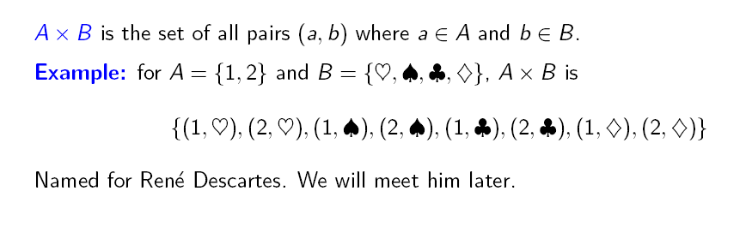
Set terminology and notation: Cartesian product

Slide 7
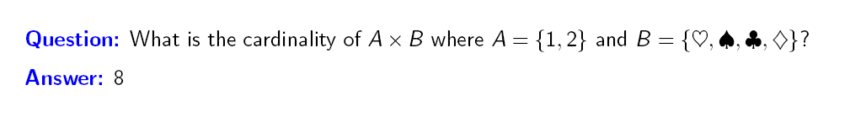
Set terminology and notation: Cartesian product

Slide 8
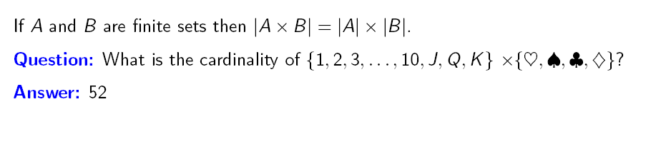
Set terminology and notation: Cartesian product

Slide 9
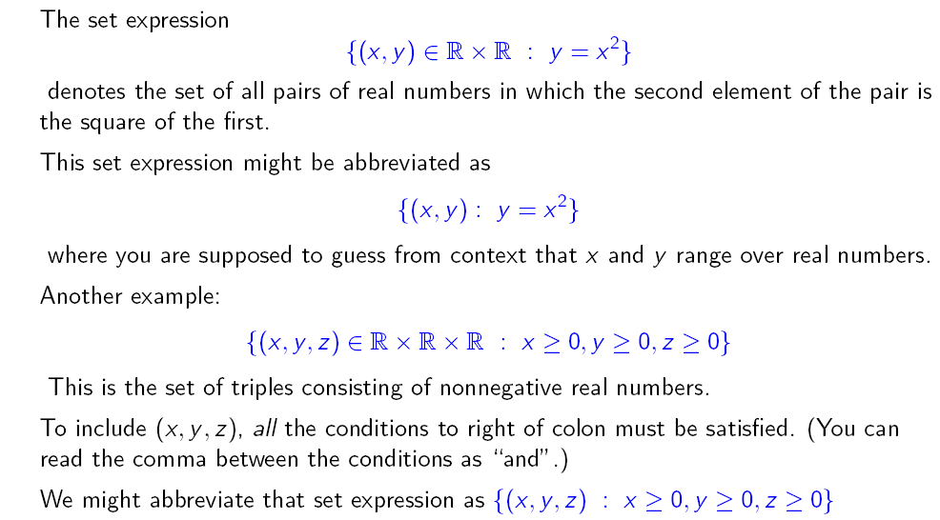
Tuples in set expressions

Slide 10
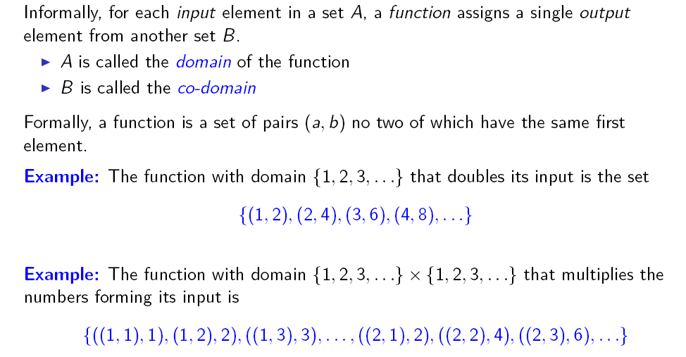
The function

Slide 11
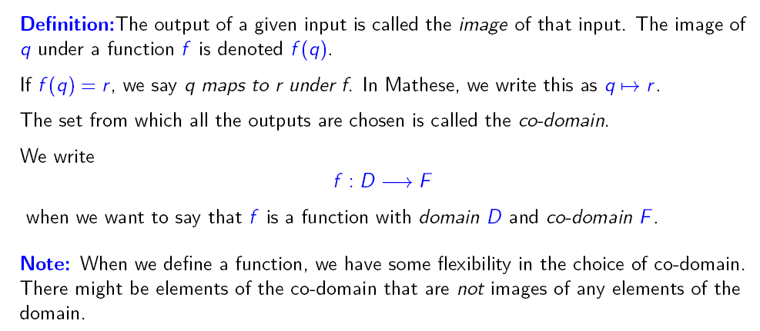
The function

Slide 12
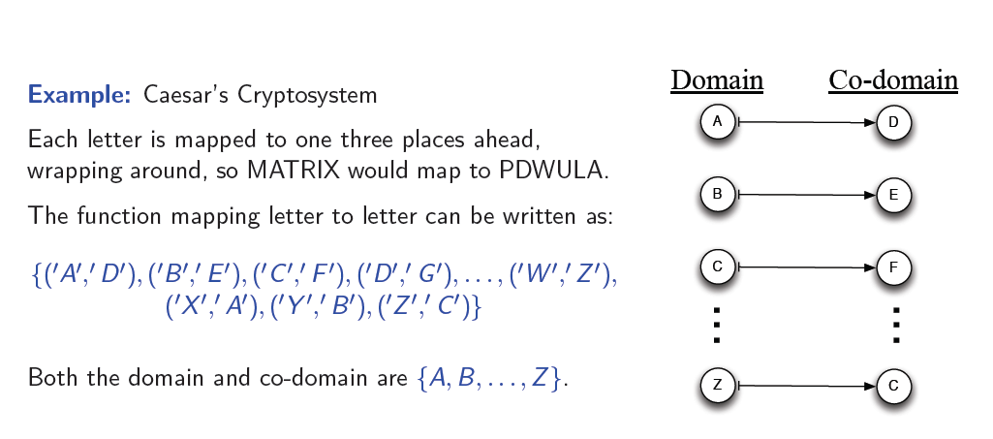
The function

Slide 13
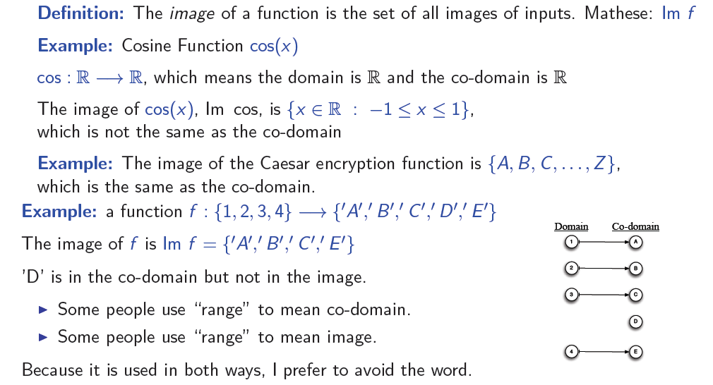
The function

Slide 14
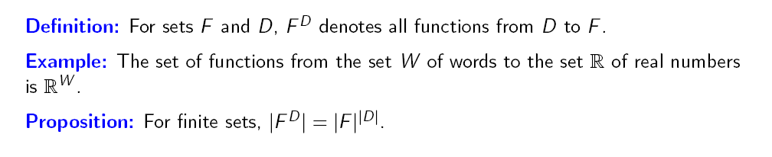
Set of functions with given domain and co-domain

Slide 15
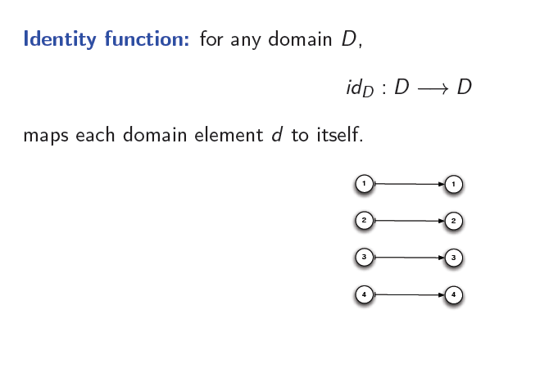
Identity function

Slide 16
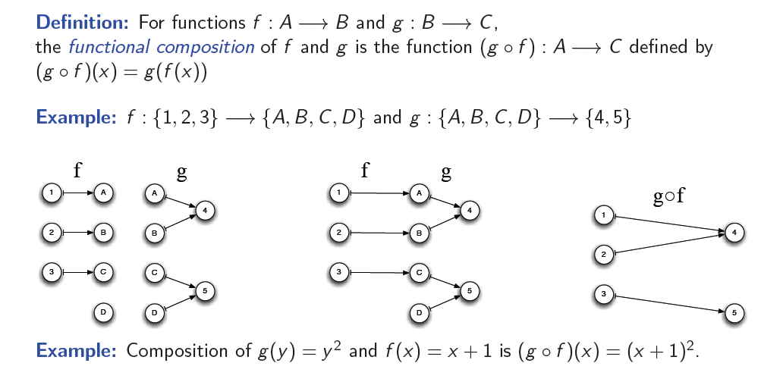
Composition

Slide 17
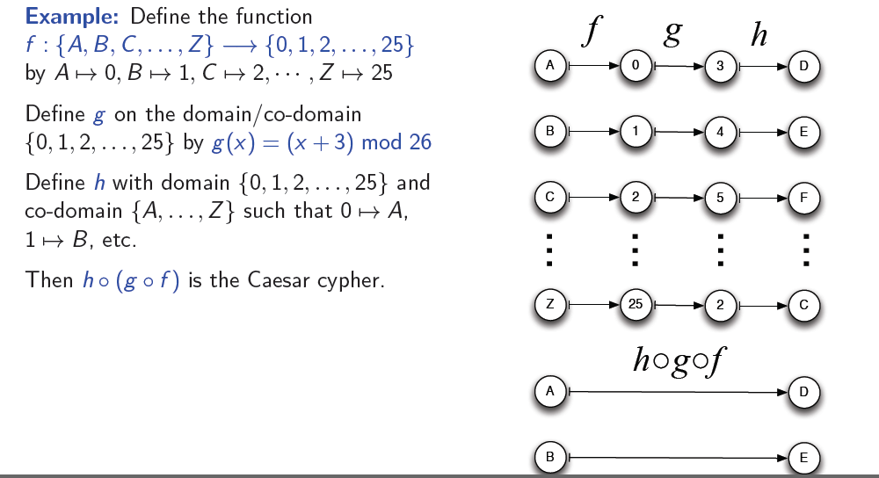
The function: Composition

Slide 18
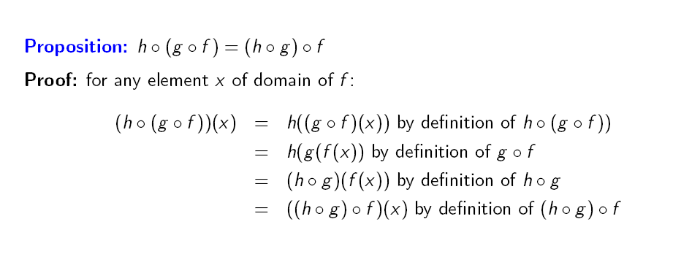
The function: Associativity of function composition

Slide 19
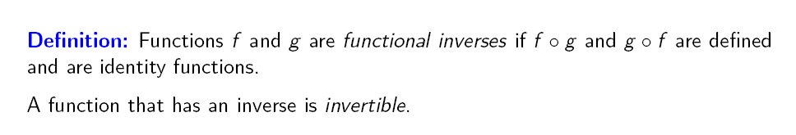
The function: Functional inverse

Slide 20
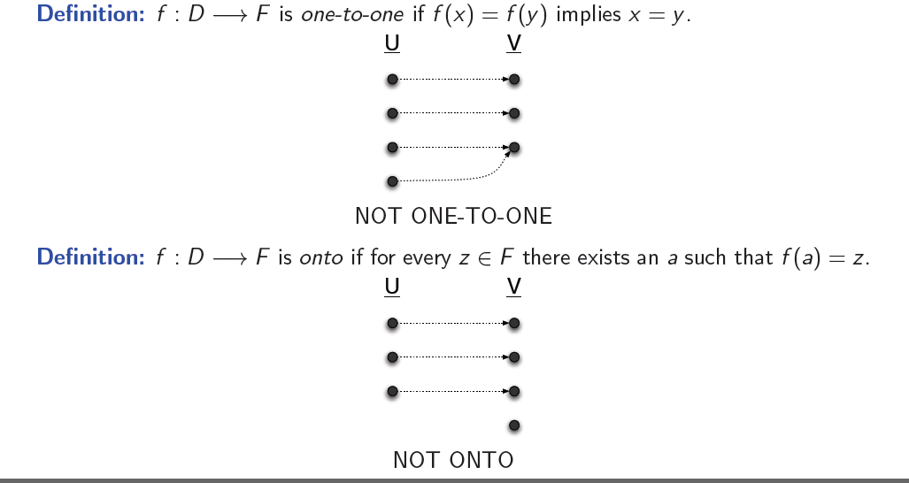
The function

Slide 21
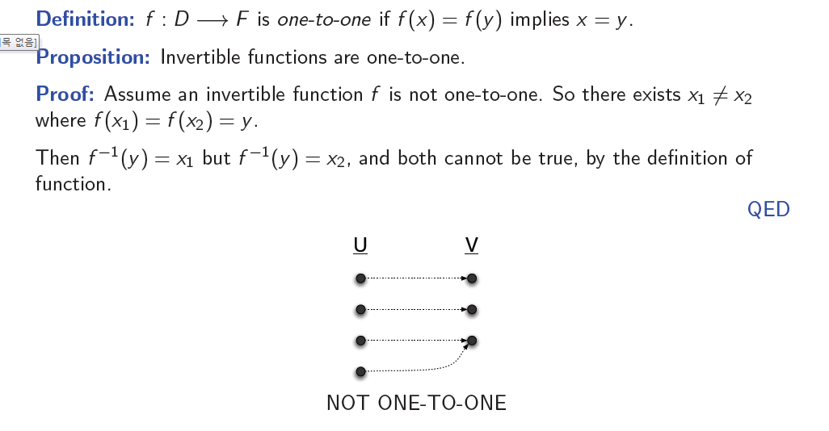
The function

Slide 22
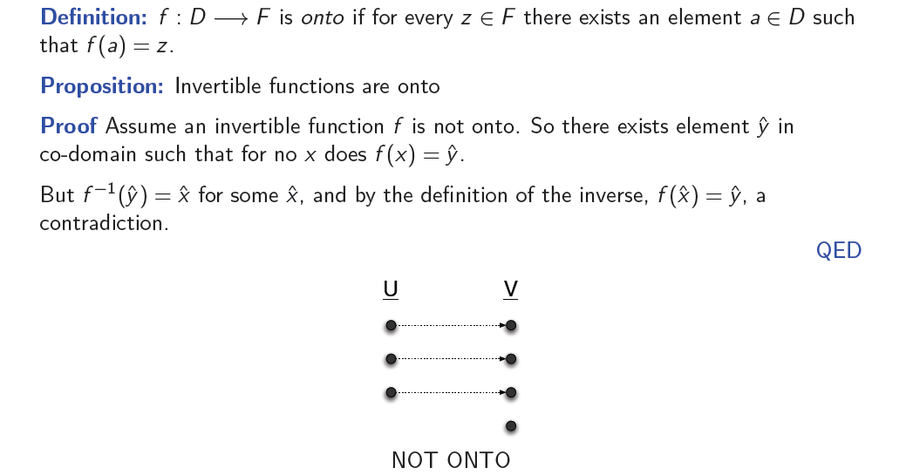
The function

Slide 23
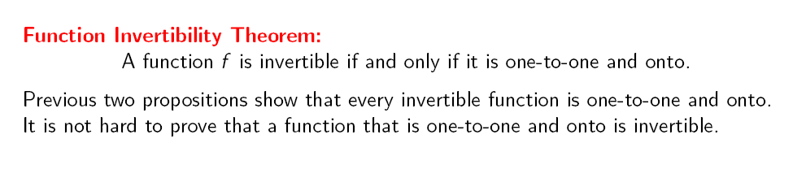
The function

Slide 24
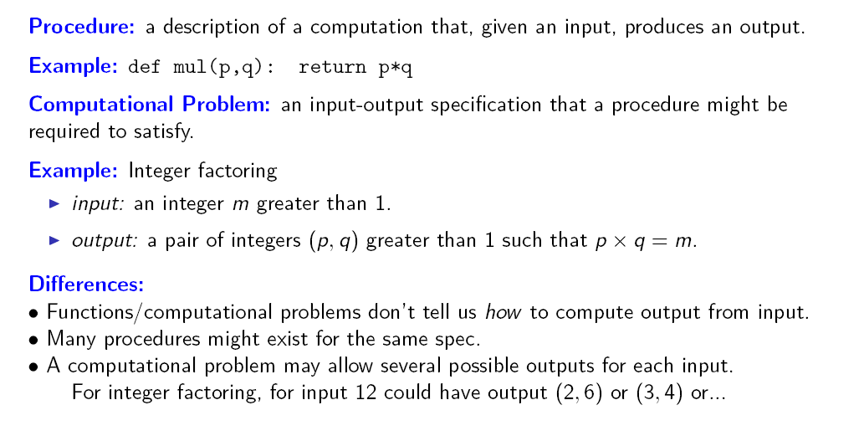
Procedure

Slide 25
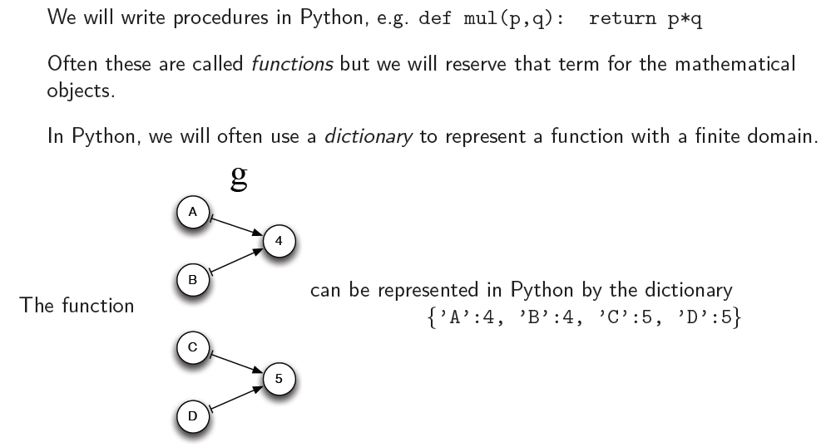
Procedures and functions in Python

Slide 26
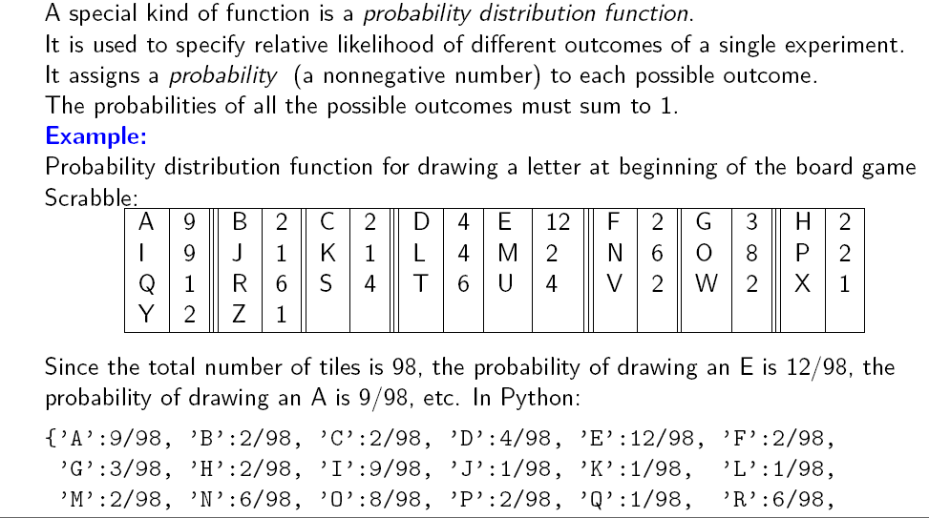
Probability distribution function

Slide 27
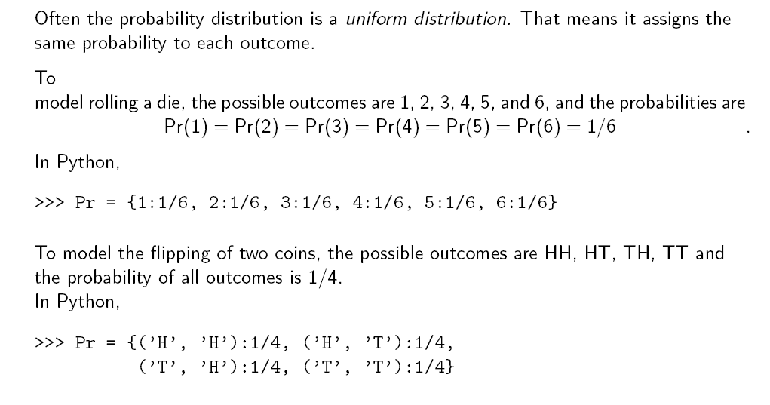
Probability distribution function: Uniform distributions

Slide 28

Q & A

